Slide 1
UNIT 2
Relational Query Language

Slide 2
Relational Algebra
Relational algebra is a procedural query language that works on relational model. The purpose of a query language is to retrieve data from database or perform various operations such as insert, update, delete on the data. When I say that relational algebra is a procedural query language, it means that it tells what data to be retrieved and how to be retrieved.
On the other hand relational calculus is a non-procedural query language, which means it tells what data to be retrieved but doesn’t tell how to retrieve it.

Slide 3
Types of operations in relational algebra
We have divided these operations in two categories:
1. Basic Operations
2. Derived Operations

Slide 4
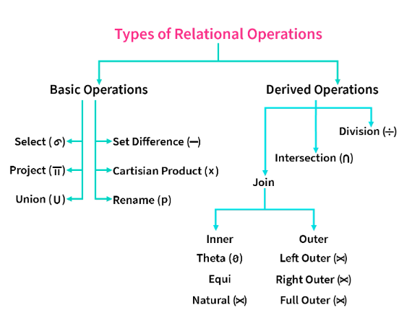

Slide 5
Basic/Fundamental Operations
1. Select (σ)
2. Project (Π)
3. Union (∪)
4. Set Difference (-)
5. Cartesian product (X)
6. Rename (ρ)

Slide 6
Derived Operations
1. Natural Join (⋈)
2. Left, Right, Full outer join (⟕, ⟕, ⟕)
3. Intersection (∩)
4. Division (÷)

Slide 7
Basic Operations

Slide 8
Select Operator (σ)
Select Operator is denoted by sigma (σ) and it is used to find the tuples (or rows) in a relation (or table) which satisfy the given condition.
Syntax of Select Operator (σ)
σ Condition/Predicate(Relation/Table name)

Slide 9
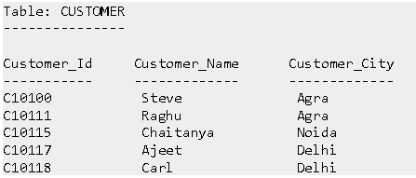
Select Operator (σ) Example

Slide 10
Select a customer who’s city name is “agra”.
Query:
σ Customer_City="Agra" (CUSTOMER)

Slide 11

Output

Slide 12
Project Operator (Π)
Project operator is denoted by Π symbol and it is used to select desired columns (or attributes) from a table (or relation).
Project operator in relational algebra is similar to the Select statement in SQL.
Duplicate entities are eliminated.

Slide 13
Syntax of Project Operator (Π)
Π column_name1, column_name2, ...., column_nameN(table_name)

Slide 14
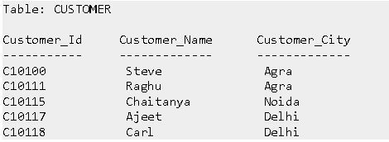
Project Operator (Π) Example
In this example, we have a table CUSTOMER with three columns, we want to fetch only two columns of the table, which we can do with the help of Project Operator Π.

Slide 15
Query
Π Customer_Name, Customer_City (CUSTOMER)

Slide 16
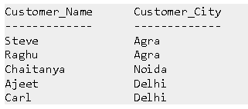
Output

Slide 17
Union Operator ( ∪ )
Union operator is denoted by ∪ symbol and it is used to select all the rows (tuples) from two tables (relations).
Lets discuss union operator a bit more. Lets say we have two relations R1 and R2 both have same columns and we want to select all the tuples(rows) from these relations then we can apply the union operator on these relations.
Note: The rows (tuples) that are present in both the tables will only appear once in the union set. In short you can say that there are no duplicates present after the union operation.

Slide 18
Syntax of Union Operator (∪)
table_name1 ∪ table_name2

Slide 19
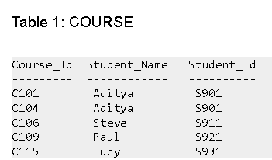
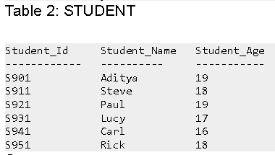
Union Operator (∪) Example

Slide 20
Query
Π Student_Name (COURSE) ∪ Π Student_Name (STUDENT)

Slide 21


Output

Slide 22
Note:
As you can see there are no duplicate names present in the output even though we had few common names in both the tables, also in the COURSE table we had the duplicate name itself.
If relations don't have the same set of attributes, then the union of such relations will result in NULL.

Slide 23
Intersection Operator ( ∩ )
Intersection operator is denoted by ∩ symbol and it is used to select common rows (tuples) from two tables (relations).
Lets say we have two relations R1 and R2 both have same columns and we want to select all those tuples(rows) that are present in both the relations, then in that case we can apply intersection operation on these two relations R1 ∩ R2.
Note: Only those rows that are present in both the tables will appear in the result set.

Slide 24
Syntax of Intersection Operator (∩)
table_name1 ∩ table_name2

Slide 25
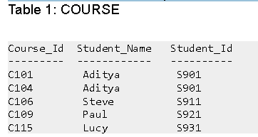
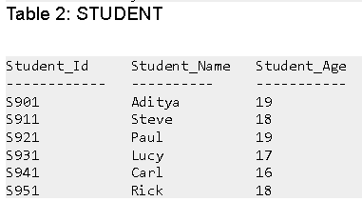
Intersection Operator (∩) Example
Lets take the same example that we have taken above.

Slide 26


Query:
Π Student_Name (COURSE) ∩ Π Student_Name (STUDENT)
Output:

Slide 27
Set Difference (-)
Set Difference is denoted by – symbol. Lets say we have two relations R1 and R2 and we want to select all those tuples(rows) that are present in Relation R1 but not present in Relation R2, this can be done using Set difference R1 – R2.
Syntax of Set Difference (-)
table_name1 - table_name2

Slide 28
Set Difference (-) Example
Lets take the same tables COURSE and STUDENT that we have seen above.
Lets write a query to select those student names that are present in STUDENT table but not present in COURSE table.
Query:
Π Student_Name (STUDENT) - Π Student_Name (COURSE)

Slide 29

Output

Slide 30
Note
Just like union, the set difference also comes with the exception of the same set of attributes in both relations.

Slide 31
Cartesian product (X)
Cartesian Product is denoted by X symbol.
Lets say we have two relations R1 and R2 then the cartesian product of these two relations (R1 X R2) would combine each tuple of first relation R1 with the each tuple of second relation R2.
Syntax of Cartesian product (X)
R1 X R2

Slide 32
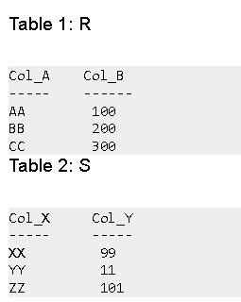
Cartesian product (X) Example

Slide 33
Query:
Lets find the cartesian product of table R and S.
R X S

Slide 34
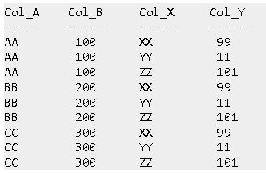
Output

Slide 35
Note
The number of rows in the output will always be the cross product of number of rows in each table. In our example table 1 has 3 rows and table 2 has 3 rows so the output has 3×3 = 9 rows.

Slide 36
Rename (ρ)
Rename (ρ) operation can be used to rename a relation or an attribute of a relation.
Rename operation is denoted by "Rho"(ρ).
Rename (ρ) Syntax:
ρ(new_relation_name, old_relation_name)

Slide 37
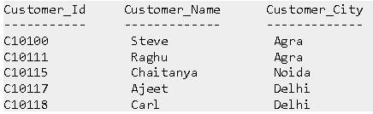
Rename (ρ) Example
Lets say we have a table customer, we are fetching customer names and we are renaming the resulted relation to CUST_NAMES.

Slide 38
Query:
ρ(CUST_NAMES, Π(Customer_Name)(CUSTOMER))

Slide 39
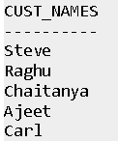
Output

Slide 40
Takeaway
Select (σ) is used to retrieve tuples(rows) based on certain conditions.
Project (∏) is used to retrieve attributes(columns) from the relation.
Union (∪) is used to retrieve all the tuples from two relations.
Set Difference (-) is used to retrieve the tuples which are present in R but not in S(R-S).
Cartesian product (X) is used to combine each tuple from first relation with each tuple from second relation.
Rename (ρ) is used to rename the output relation.

Slide 41
Task
Consider the following schema
Flight( FlightNo: Number, FlightName: String, Source: String, Destination: String)
Display the information of the flights whose FlightNo is greater than 1105.
Display the FlightName for which the Source is London
Display the information of all the flight going (Destination)to Singapore

Slide 42
Derived Operations

Slide 43
Derived Operations
These operations can be derived from basic operations and hence named Derived Operations, Also known as extended operations.
These include three operations: Join Operations, Intersection operations, and Division operations.

Slide 44
Division (÷)
Division Operation is represented by "division"(÷ or /) operator and is used in queries that involve keywords "every", "all", etc. Notation : R(X,Y)/S(Y)
Here, R is the first relation from which data is retrieved.
S is the second relation that will help to retrieve the data. X and Y are the attributes/columns present in relation.
We can have multiple attributes in relation, but keep in mind that attributes of S must be a proper subset of attributes of R.

Slide 45
For each corresponding value of Y, the above notation will return us the value of X from tuple<X,Y> which exists everywhere.

Slide 46
Example
Let's have two relations, ENROLLED and COURSE. ENROLLED consist of two attributes STUDENT_ID and COURSE_ID. It denotes the map of students who are enrolled in given courses.
COURSE contains the list of courses available. See, here attributes/columns of COURSE relation are a proper subset of attributes/columns of ENROLLED relation. Hence Division operation can be used here.

Slide 47
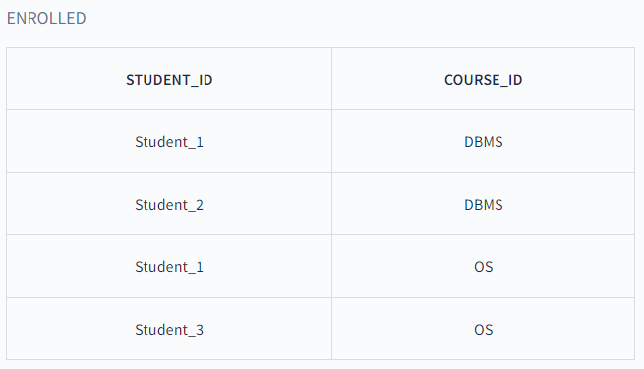
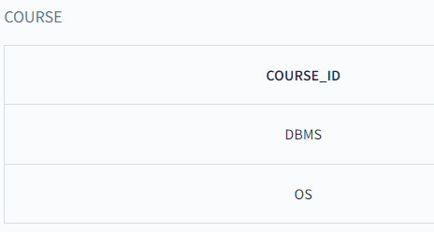

Slide 48
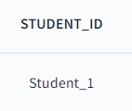
Now the query is to return the STUDENT_ID of students who are enrolled in every course.
ENROLLED(STUDENT_ID, COURSE_ID)/COURSE(COURSE_ID)
Output:

Slide 49
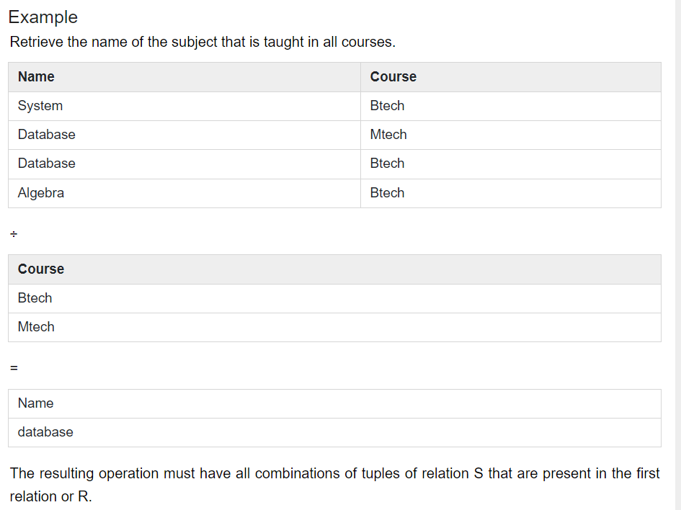

Slide 50
Join Operations
Join in DBMS is a binary operation which allows you to combine join product and selection in one single statement.
The goal of creating a join condition is that it helps you to combine the data from two or more DBMS tables.
The tables in DBMS are associated using the primary key and foreign keys.
Notes:
A Join operation combines related tuples from different relations, if and only if a given join condition is satisfied. It is denoted by ⋈.

Slide 51
Types of Join
There are mainly two types of joins in DBMS:
Inner Joins: Theta, Natural, EQUI
Outer Join: Left, Right, Full

Slide 52
Inner Join
Inner Join is used to return rows from both tables which satisfy the given condition. It is the most widely used join operation and can be considered as a default join-type
Inner Join further divided into three subtypes:
Theta join
Natural join
EQUI join

Slide 53

Theta Join
Theta Join allows you to merge two tables based on the condition represented by theta. Theta joins work for all comparison operators. It is denoted by symbol θ. The general case of JOIN operation is called a Theta join.
Syntax:

Slide 54
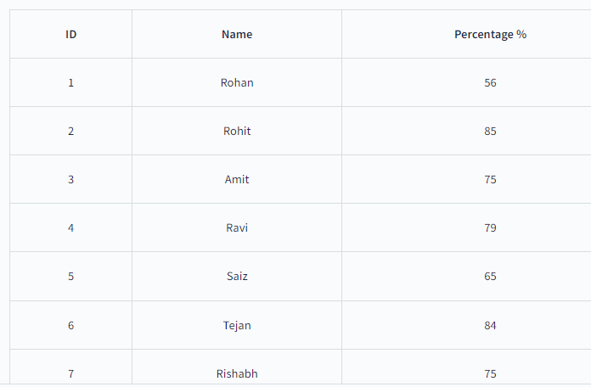
Boys table

Slide 55
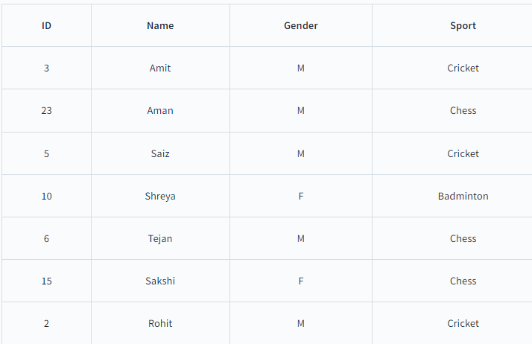
Interest table

Slide 56
What if we want to find all the boys student in class 12th who like chess and have percentage greater than 70%. How can we find it out with the help of Theta join?
Theta Join - Boys ⋈(Boys.ID = Interest.ID and Interest.Sport = Chess and Boys.Percentage > 70 ) Interest So the condition here is Boys.ID = Interest.ID and Interest.Sport = Chess ,
so while performing join, we will have to check this condition every time two rows are joined.

Slide 57
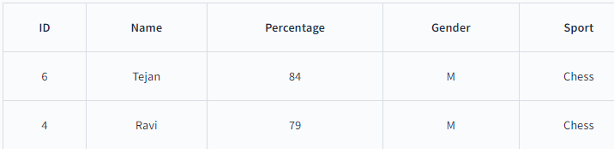
Result of theta join

Slide 58
EQUI Join
Equi join is same as Theta Join, but the only condition is it only uses equivalence condition while performing join between two tables.
A ⋈(... = ...) B, where (... = ... ) is the equivalence condition on any of the attributes of the joining table.
In the above example, what if we are told to find out all the students of class 12th who have interest in chess only?
We can perform Equi join as :
Equi join: Boys ⋈(Boys.ID = Interset.ID and Interest.Sport = Chess) Interest

Slide 59
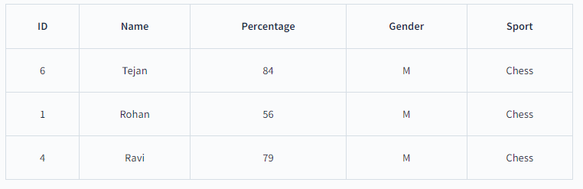
After equi join

Slide 60
Natural Join (⋈)
Natural Join does not utilize any of the comparison operators. In this type of join, the attributes should have the same name and domain.
In Natural Join, there should be at least one common attribute between two relations.
It performs selection forming equality on those attributes which appear in both relations and eliminates the duplicate attributes.

Slide 61
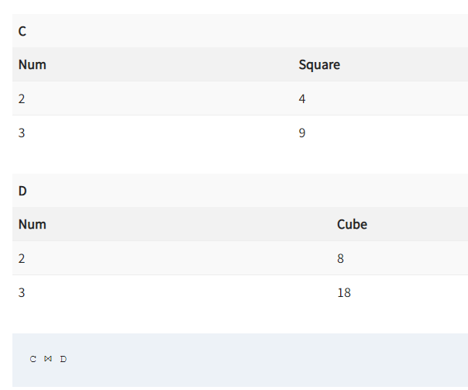
Example

Slide 62
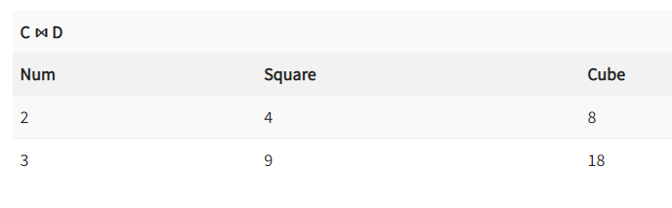
Example

Slide 63
Outer Join
An Outer Join doesn’t require each record in the two join tables to have a matching record. In this type of join, the table retains each record even if no other matching record exists.
Three types of Outer Joins are:
Left Outer Join
Right Outer Join
Full Outer Join

Slide 64
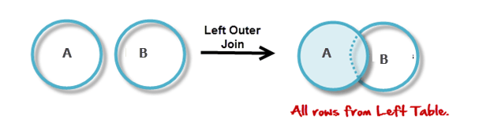
Left Outer Join
Left Outer Join returns all the rows from the table on the left even if no matching rows have been found in the table on the right. When no matching record is found in the table on the right, NULL is returned.

Slide 65
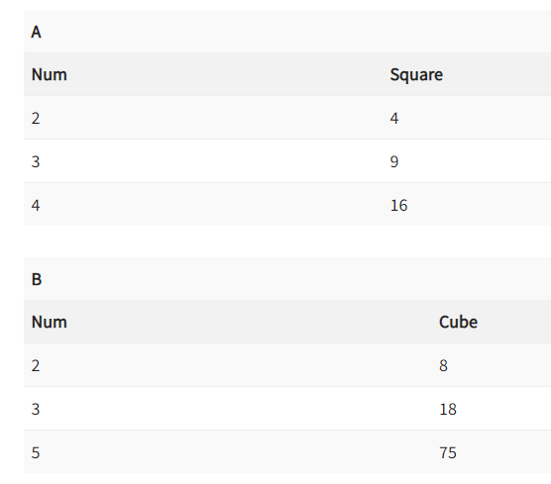
Example

Slide 66
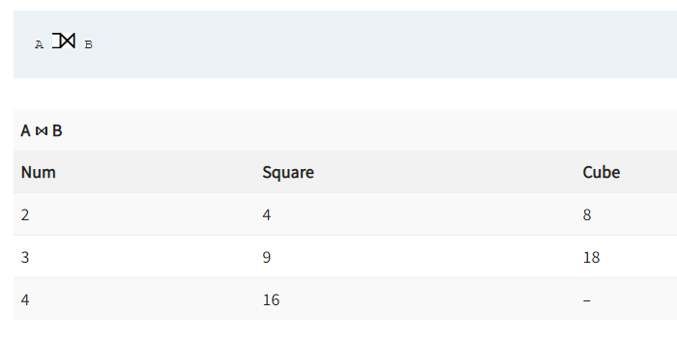

Slide 67
Right Outer Join
Right Outer Join returns all the columns from the table on the right even if no matching rows have been found in the table on the left. Where no matches have been found in the table on the left, NULL is returned. RIGHT outer JOIN is the opposite of LEFT JOIN
In our example, let’s assume that you need to get the names of members and movies rented by them. Now we have a new member who has not rented any movie yet.

Slide 68
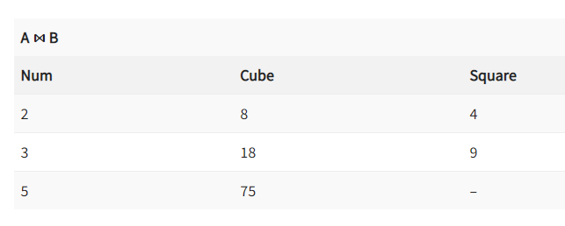

Slide 69
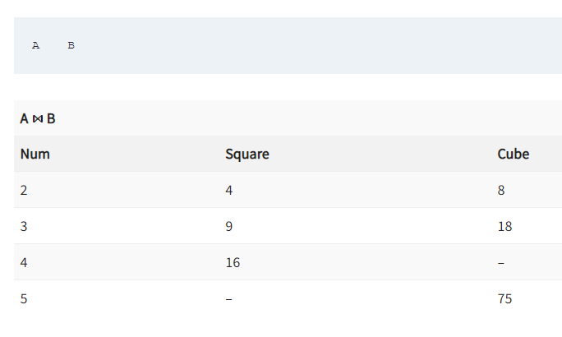
Full Outer Join
In a Full Outer Join , all tuples from both relations are included in the result, irrespective of the matching condition.

